Slide 1


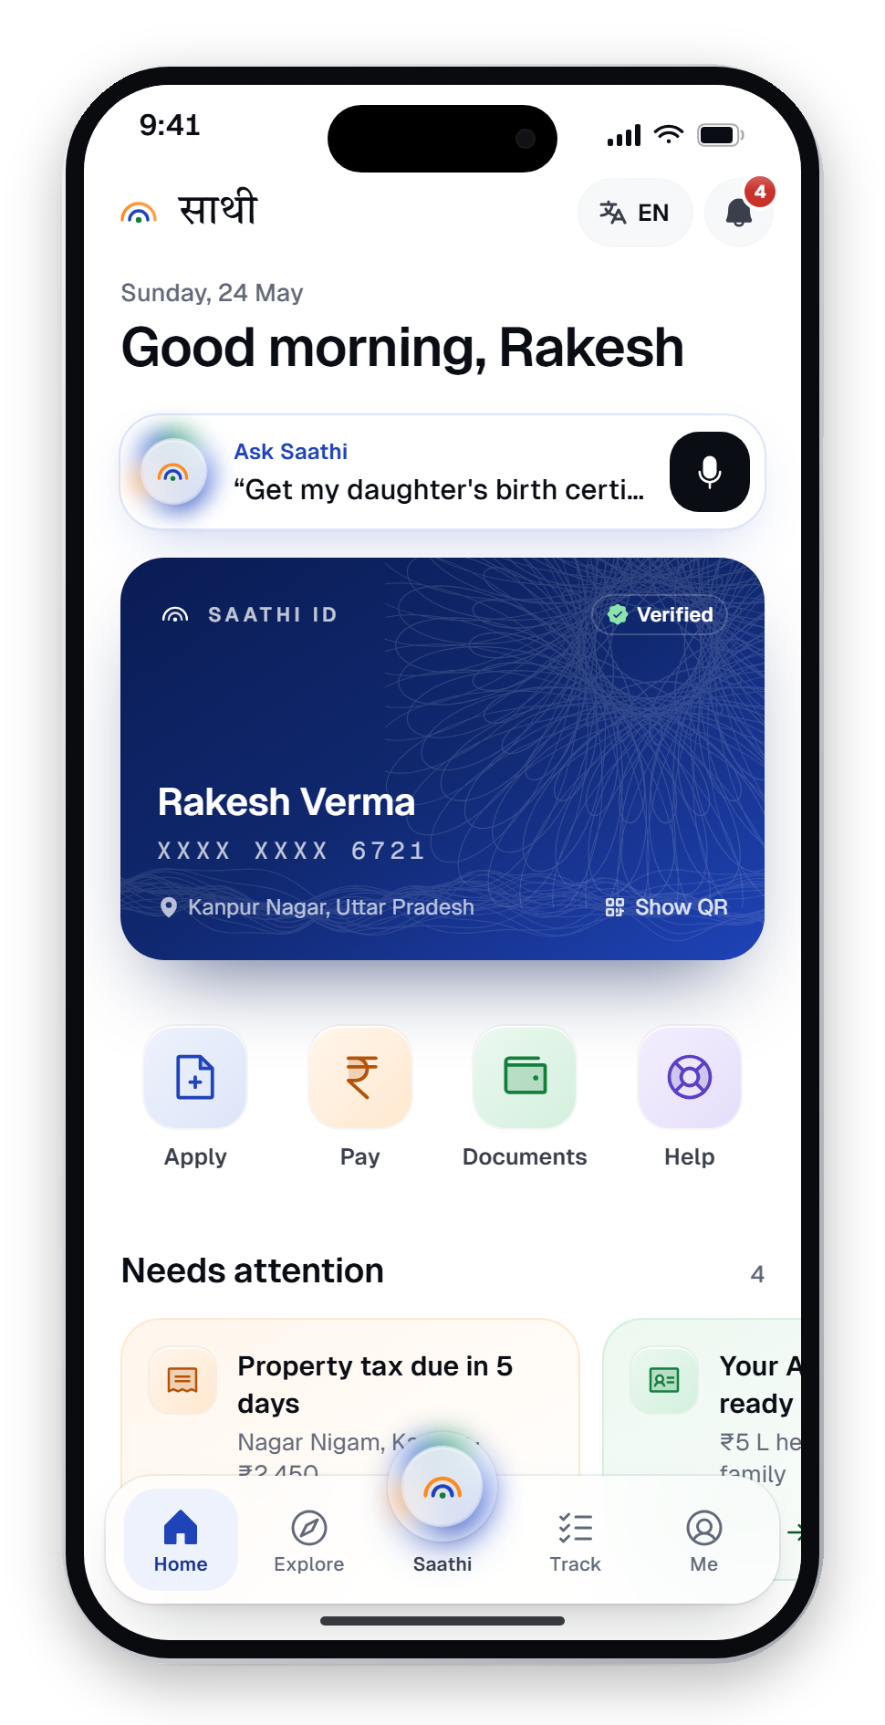
साथी
SAATHI
Minor Project · Phase 1
Project Identification & Definition
Smart City Citizen
Services App
Saathi — one door to every government service. A multilingual, voice-first citizen app with an assistant that asks before it acts.
SUBMITTED BY
DEPARTMENT
Krishom Sharma
UIC
BCA (UI/UX Designs)
University Institute of Computing
UID — 24BCU10002
A design concept. Not affiliated with the Government of India.

Slide 2
What this phase covers
Phase 1 identifies the problem worth solving and defines the project around it.
01
Project at a glance
06
Target users
Title, domain, type and what was built
Four personas, four very different needs
02
Background
07
Objectives
India's digital rails — and the missing front door
Six things the project sets out to achieve
03
Problem identification
08
Proposed solution
Hundreds of apps, three recurring frictions
Saathi — one door to every service
04
Smart-city context
09
Expected outcomes
Where citizens meet the city, every day
Design targets and why it matters
05
Problem statement
The single question this project answers

Slide 3




Project at a glance
A smart-city citizen services app, designed end to end and built as a working prototype.
Project title
Smart City Citizen Services App — “Saathi”
42
17
Domain
Civic tech · Smart cities · Government UX (GovTech)
government processes modelled on their real portals
languages live today; 6 more of the Eighth Schedule coming
Project type
Minor project — UI/UX design + interactive prototype
Platform
Mobile app (iPhone prototype) + website + department console
15
1
Framed by
Smart Cities Mission · Digital India · Viksit Bharat @2047
department consoles — the other side of the counter
assistant that never submits without your “yes”
Deliverables
Research, design system, prototype, case study, website

Slide 4




The rails are built. The door is missing.
India already runs the largest digital public infrastructure in the world.
142 crore+
23.2 billion
70 crore+
Aadhaar numbers issued
UPI payments in May 2026 alone
DigiLocker accounts
Yet a citizen still has to know which app, which portal and which form. A smart city needs a front door those rails were waiting for — built on them, not beside them.
Sources: Aadhaar IDs (Apr 2025, indiantelevision.com) · NPCI UPI data, May 2026 (Tribune India) · DigiLocker users 2026 (Organiser). Figures as cited on the Saathi website.

Slide 5
Hundreds of apps. No single door.
The maze itself is the barrier.
A citizen who wants to register a birth, pay property tax or check a pension doesn't deal with one government. They deal with dozens — each with its own app, login, language and idea of how a form should work.
Services exist, but finding the real one — not a lookalike, not a middleman — takes confidence, data and patience that the people who need help most often don't have.
“
मुझे पता है कि सब online है, but मुझे ये नहीं पता कि कौन सा online असली है.
“I know everything's online — I just don't know which ‘online’ is the real one.”
A FEW OF THE APPS A CITIZEN IS EXPECTED TO JUGGLE
UMANG
DigiLocker
mAadhaar
mParivahan
e-Shram
DigiYatra
Ayushman
EPFO
NSP
Rakesh, 34 — shopkeeper, Kanpur · user research
Bhulekh
PFMS
Income Tax

Slide 6


Three frictions, again and again
Conversations with citizens in cities, small towns and villages about the last time they used a government service.
Language
Trust
Where to start
Forms fall back to English. Citizens who read slowly — or read a different script — need someone else to fill them in.
Fake portals sit one search result away. People double-check everything, and middlemen charge for the confidence.
Services are organised by department. Citizens think in life events — a birth, a job, a move — not ministries.
“I can speak it. I can't always read it.” — Sunita, rural Bihar
“If it looks official, I still double-check. Twice.” — Rakesh, Kanpur
“Don't hurry me. Just tell me clearly.” — Vikram, Chennai

Slide 7






Where citizens meet the city
A smart city is judged at its counters. These are the everyday touchpoints Saathi brings behind one door.
Municipal services
Mobility
Health
Property tax, birth & death certificates, trade licences — Nagar Nigam
Driving licence renewal, vehicle services and traffic challans — RTO
Ayushman card, vaccinations and hospital records
Welfare & pensions
Identity & documents
Grievances
Old-age pension, life certificates, maternity and farmer schemes
Aadhaar, PAN, voter ID — a verified wallet via DigiLocker
Escalate a delay to the grievance cell, with the case already filled in

Slide 8

Citizens of a smart city still have to find the right app, portal and form among hundreds
PROBLEM STATEMENT
— often in a language that isn't theirs, with no way to tell a real portal from a fake, and no idea what they are entitled to.
How might we design one trustworthy, multilingual door to every city service — that starts from the citizen's life, not from a department?

Slide 9
Four people. Four very different needs.
Target users, drawn from research across tier-2 cities, villages, seniors and urban professionals.
RV
SD
VS
AS
Rakesh Verma
Sunita Devi
Vikram Singh
Ananya Sharma
34 · Tier-2 · Kanpur
29 · Rural · Bihar
68 · Senior · Chennai
26 · Urban · Bengaluru
Shopkeeper. Smartphone-confident, burned by fake-portal scams.
Farmer. Low literacy, shares one phone with the family.
Retired teacher. Patient, careful, prefers Tamil.
Analyst. Fluent in English, zero patience for friction.
Trust he can verify · Hindi-first
Voice + read-aloud · weak signal
Larger text · slow mode · Tamil
Speed · saveable receipts

Slide 10




Six objectives
What the project sets out to achieve.
01
Organise by life, not department
02
Vernacular-first, in 22 languages
Reach every service through life moments, needs and entitlements.
Every screen and form in the citizen's own language and script.
03
Voice and accessibility by default
04
An assistant that acts — and asks first
Voice on every field, read-aloud, slow mode and larger text.
Plan, show sources, take consent, then do the paperwork.
05
Make status sacred
06
Trust and privacy you can check
Every application tracked with stages, named officers and dates.
DPDP-style consent, an access log and verifiable receipts.

Slide 11
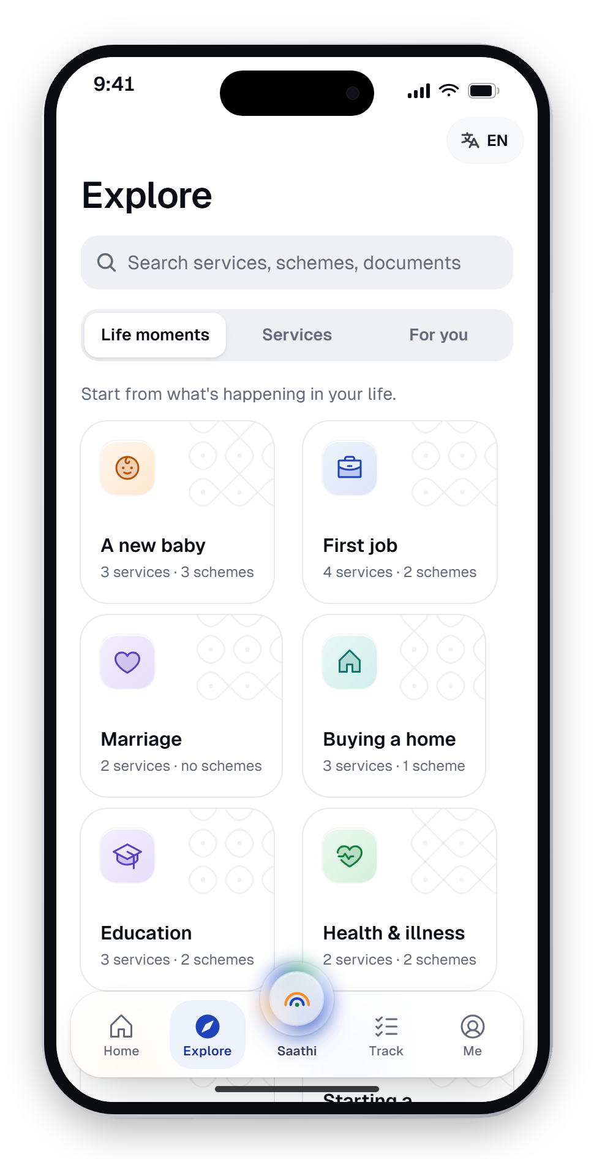
Saathi — one door
Citizens don't think in departments. They think in moments, needs and entitlements.
A citizen app that starts from your life. Ask in your own language — Saathi finds what you're entitled to, fills in the forms and keeps the receipts.
Moments
Needs
Citizen
Built on India Stack
Aadhaar, DigiLocker, UPI, Bhashini (conceptual)
Both sides of the counter
Citizen app + 15 department consoles
Entitlements
Ask before acting
Nothing submitted without consent

Slide 12
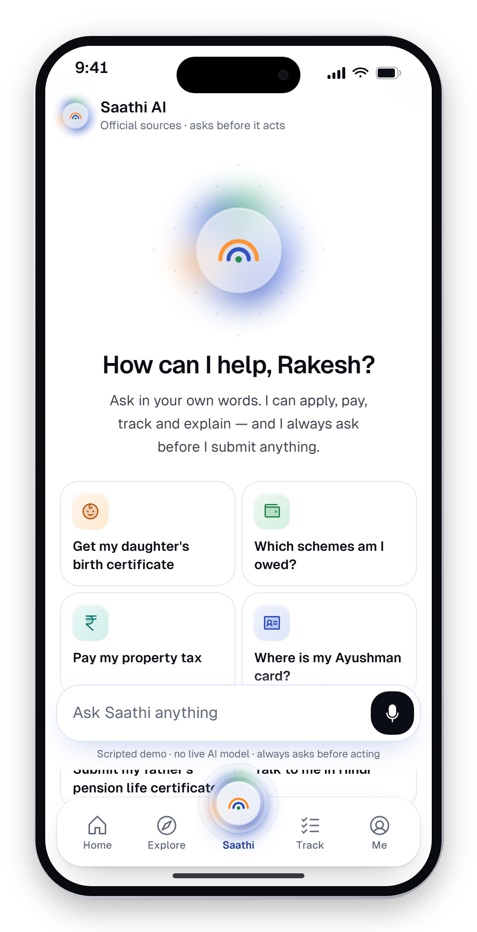
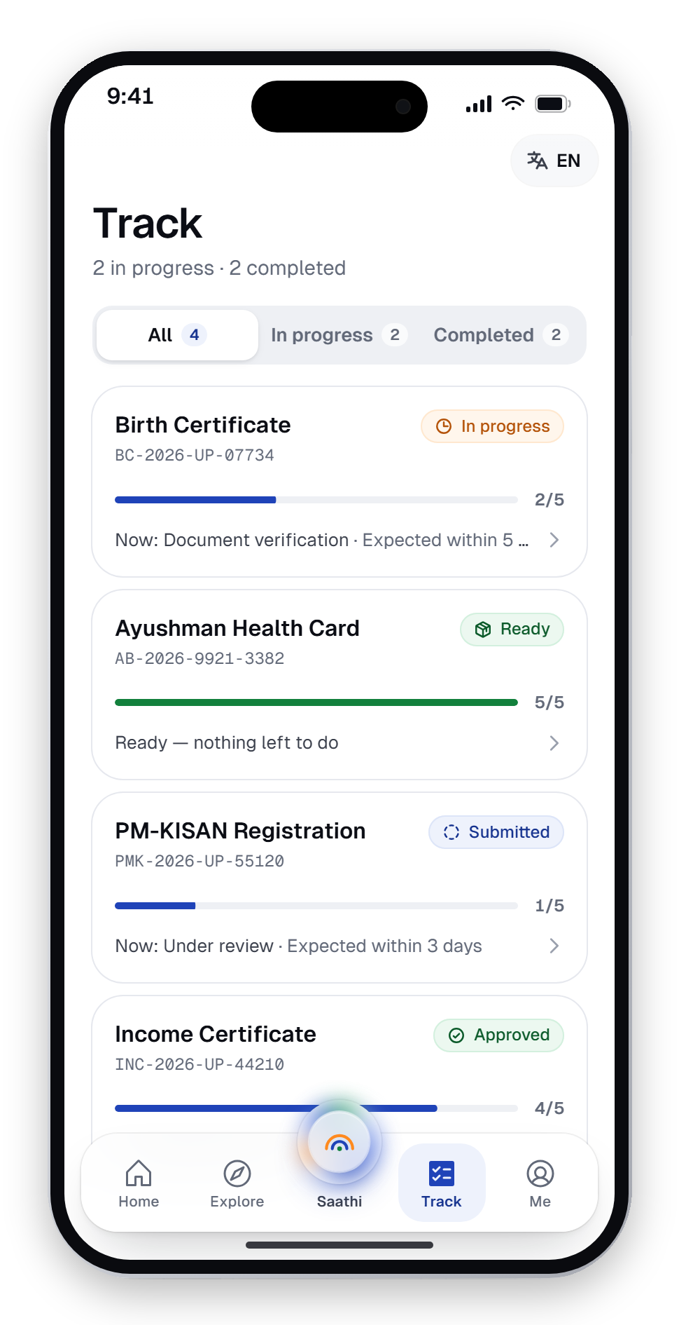
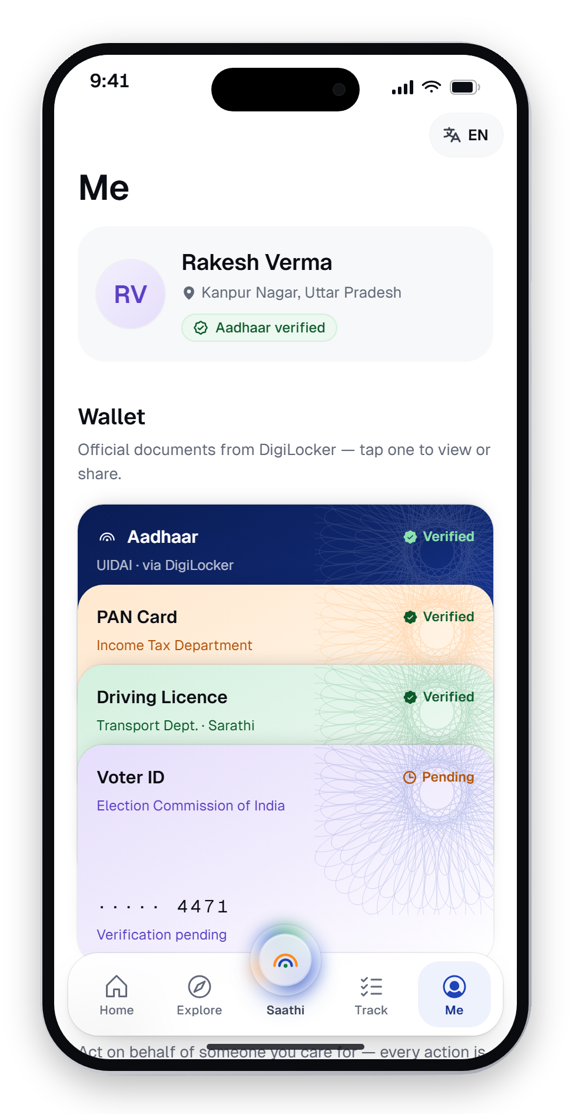
What the app does
Five tabs, with the assistant in the centre.
Home
Saathi AI
Track
Me
Identity card, what needs attention, your applications
Ask in any words — it plans, asks, then acts
Stages, named officers and expected dates
Document wallet, family proxy, privacy dashboard

Slide 13
How we'd know it works
Design targets for a pilot — not results — so the design can be judged against something measurable.
5 min
90%
0
1 in 3
to apply for a birth certificate, from a first-time user's first tap
of test participants complete a key flow without help
applications submitted or payments made without explicit consent
form fields filled by voice among low-literacy participants
SIGNIFICANCE — THE FOUR PILLARS OF VIKSIT BHARAT
गरीब
युवा
अन्नदाता
नारी
Garib
Yuva
Annadata
Nari
Entitlements find people, not the other way round.
Scholarships, skills and a first job in one place.
Land records and PM-KISAN, by voice.
Maternity benefits and a daughter's savings, as one checklist.

Slide 14

Thank you.
Phase 1 identified the problem — a maze of apps — and defined Saathi as one trustworthy door for the citizens of a smart city.
NEXT · PHASE 2
Project scope and literature review: what is in and out, and what standards, platforms and research the design stands on.
Krishom Sharma · BCA (UI/UX Designs) · UID 24BCU10002

